Slide 1

Evaluation of co-op experiences based on students and employers feedback

Slide 2






INTRODUCTION
CO-OP EXPERIENCES
STUDENT CHALLENGES
EMPLOYEE INSIGHTS
DATA ANALYSIS
PERSISTANT CHALLENGES
INTERACTIVE DASHBOARD

Slide 3
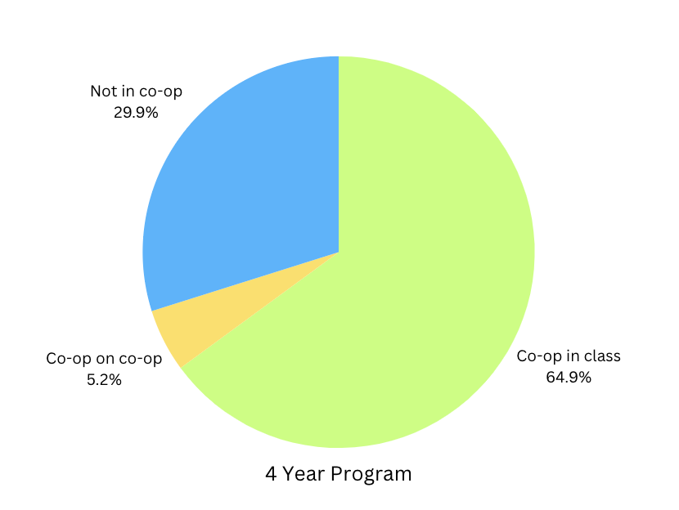
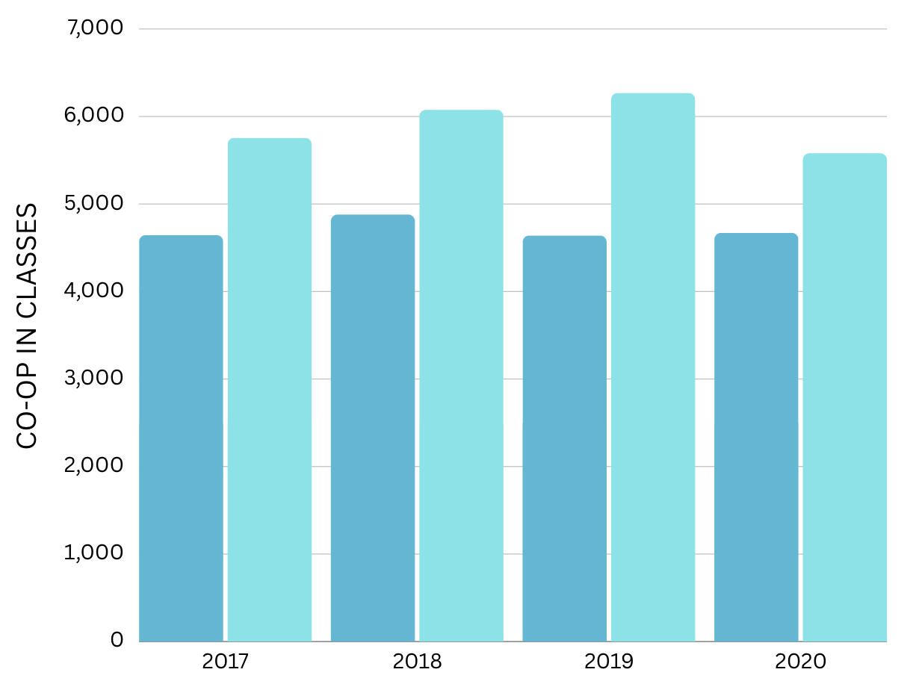
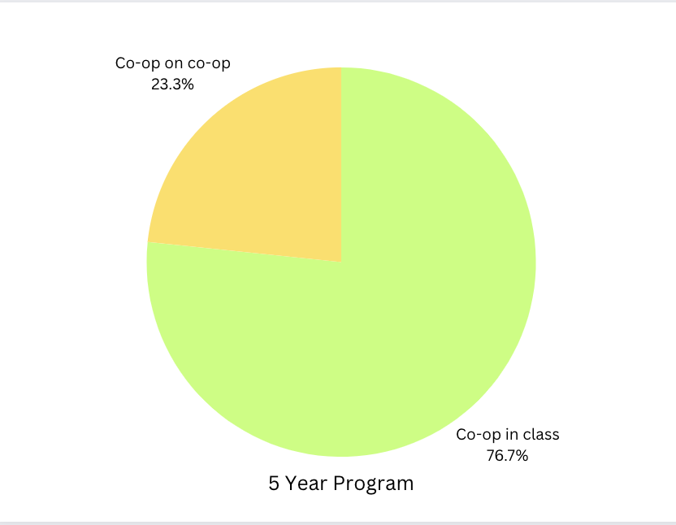
NO OF PEOPLE REGISTERED FOR CO-OP
YEARS
4 Year Program
5 Year Program

Slide 4
Questions
What were the strengths of students from various majors over the years?
What were the weaknesses of students from various majors over the years?
Which coursework was used by students from various majors over these years?
What were the skills used by students from various majors over these years?
What are the skills that students from various majors feel they need to develop?

Slide 5
Suggestions
Workshops can be held for Python and other programming languages
Zero credit courses can be introduced for Networking and other important skills.
Details from employers to be collected mandatorily as forms.

Slide 6
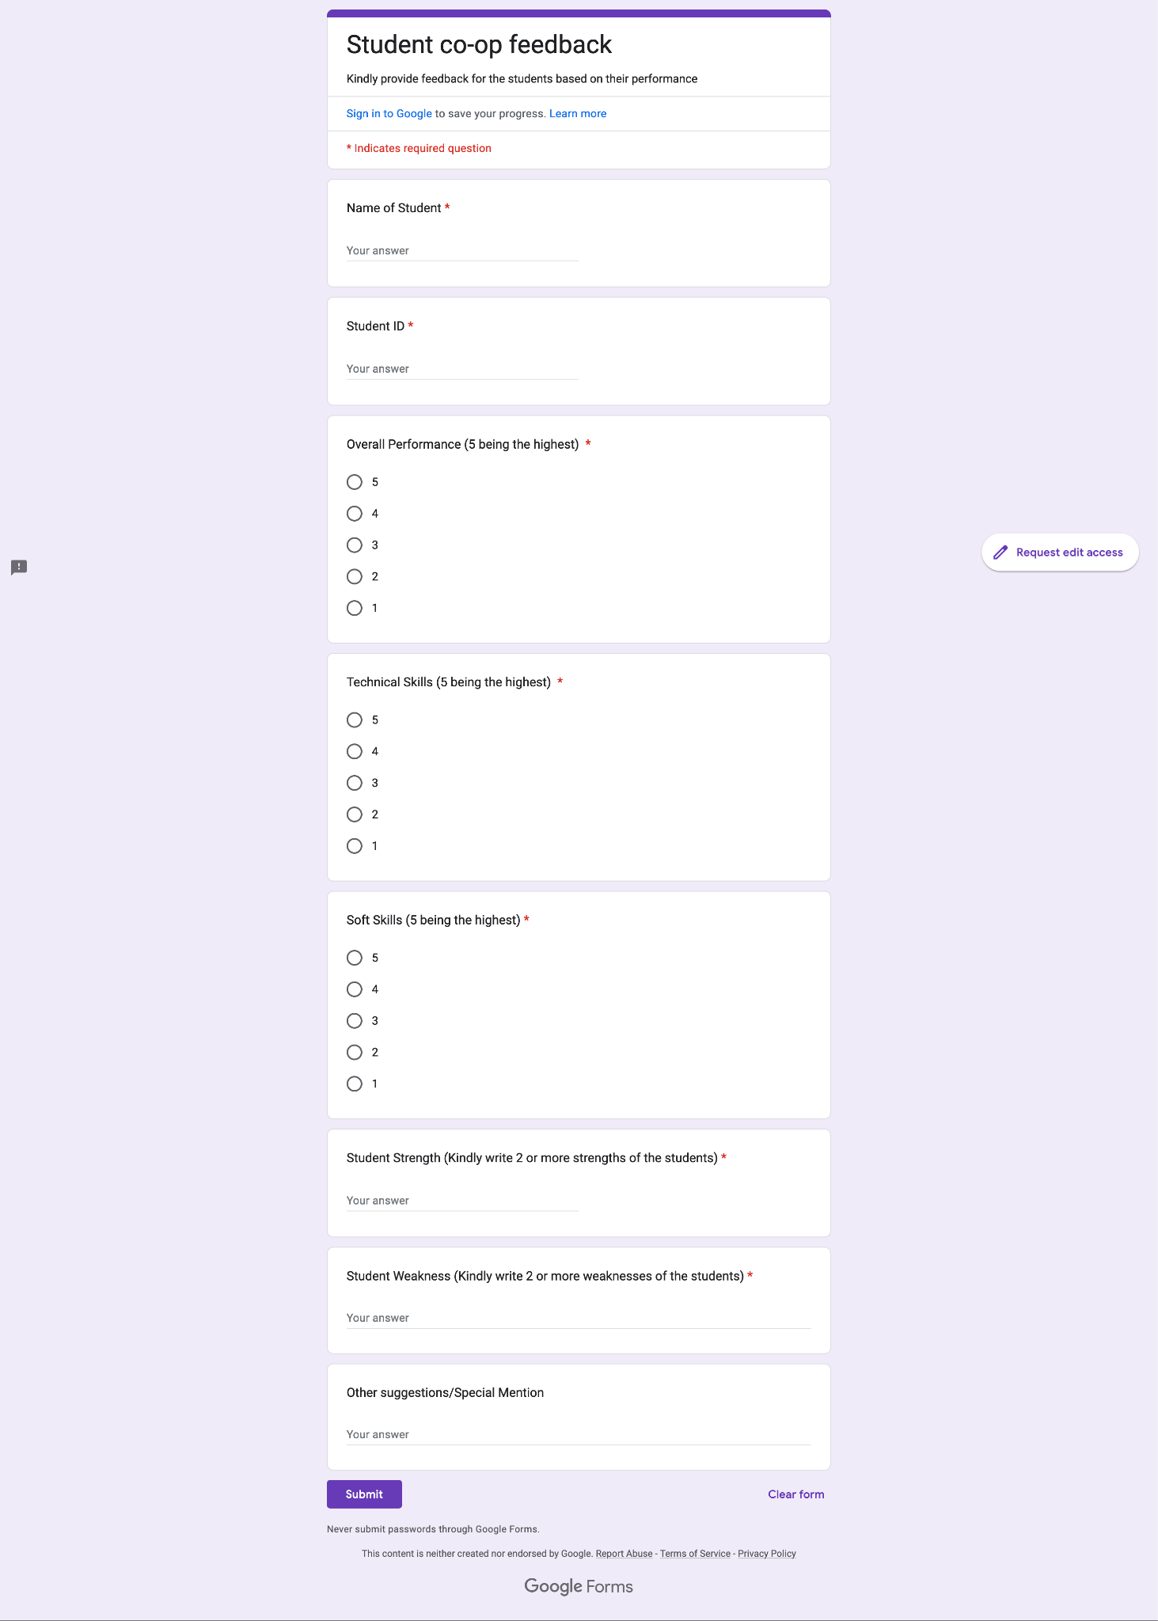

Slide 7
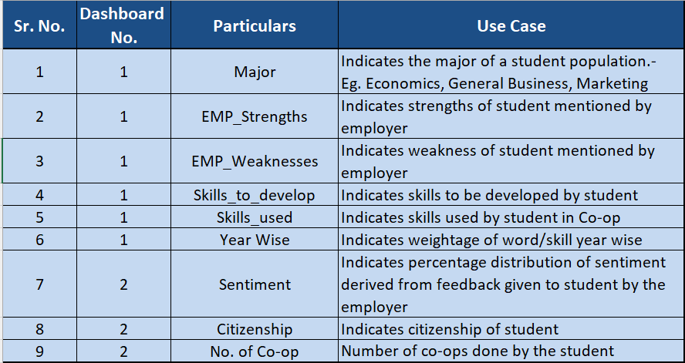
Data Dictionary

